Slide 1
ISZE-ISZJ
PMS sales promotion project
International Parts Sales Dept
Group No.1
15th Jan, 2026

Slide 2
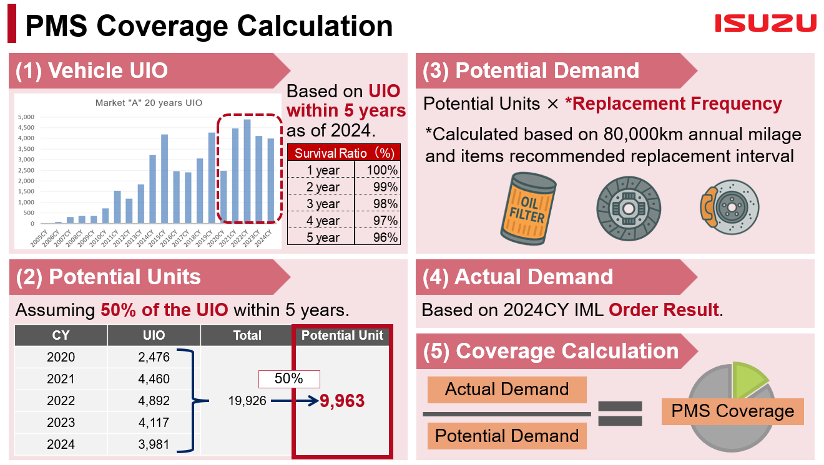
Market Research(PMS parts* sales)
*Periodic Maintenance Service parts(oil/fuel/air filter, clutch, brake)
ISZE is required OP+20% in FY27, it is essential to plan activities and implement immediately
ISZJ would like to grasp if we have been able to have parts sales for demand in vehicle life cycle
At first, it focus on PMS*, which is required for stable vehicle operation
Approach to each customer
- PMS Coverage calculation method is just one possible approach to identify sales potential
- After analysis, it should discuss how to address to market for taking sales potential
【Action】
To grasp the sales potential and current sales situation
1) Vehicle UIO
2) Potential Units(discuss the ratio depend on market)
3) Potential Demand(discuss the frequency depend on market)
4) Actual Demand
5) Coverage Calculation
To plan sales promotion activities
<CV Conference 2025_breakout Parts session>

Slide 3
PMS Analysis and Activities in ITUK
ISZE and ISZJ working together promoting activities in ITUK as a target market (on a business trip basis)
Target sales increase(QTY): filters +1%、clutch、 brake +3%
PMS parts sales data analysis
- select target vehicle model(N35/N75?) and part numbers
2) Market analysis and plan activities
- PMS parts sales promotion、ISZE and ISZE visit ITUK in order to plan activities
It is essential to delve deeper into the market and DB/DLR activities to identify effective actions
external/internal sales enhance, sales to independent repair facility, service contract with fleet etc
Clarifying points of appeal and presenting concrete measures
Tentative Schedule
 | 26.1 |  | 2 |  | 3 |  | FY27 1Q |  |  |  |  |  | 2Q |  |  |  |  |  | 3Q |  |  |  |  |  | 4Q
Explain activity
parts sales analysis
Market analysis and plan activities
Implement activities
Proposal to ITUK
data collection/analysis
market analysis
study item/activity
decision
proposal/discussion
discussion
preparation
implementation/feedback

Slide 4
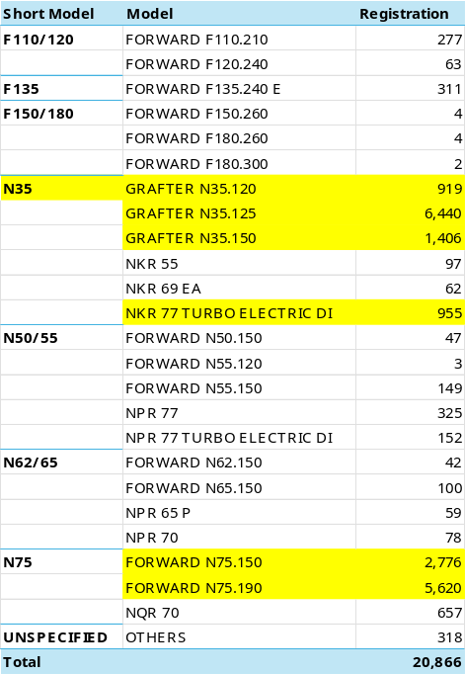
Market Research(PMS parts* sales)
*Periodic Maintenance Service parts(oil/fuel/air filter, clutch, brake)
It focus on the most popular vehicle model to check sales potential with lower workload.
Process
check popular vehicle model from VIN and select the target【(1) vehicle UIO】
decide potential UIO and replacement frequency 【(2) Potential Units/(3) Potential Demand】
find part numbers of PMS items in EQ-HIT and check sales QTY【(4) Actual Demand】
calculate coverage 【(5) Coverage Calculation】
study effective promotion activities and implement it
Ex) JAANLR87EM7105702
Category |  | Genuine | BVP | Qty/Unit | Replacement(km) | Qty/Year
Oil filter |  | - | - | 1 | 20,000 | 4
Fuel filter |  | - | - | 1 | 40,000 | 2
Air filter |  | - | - | 1 | 40,000 | 2
Clutch | Disc | - | - | 1 | 100,000 | 0.8
Brake | Shoe front | - | - | 1 | 100,000 | 0.8
 | Shoe rear | - | - | 1 | 100,000 | 0.8
 | Lining | - | - | 1 | 100,000 | 0.8
We have to discuss which item should focus on in UK market
- clutch: clutch disc, pressure plate, release bearing, pilot bearing etc
- brake: brake ASM, Kit, Lining, pad, caliper, rotor

Slide 5
(reference)
CV Conference presentation material

Slide 6
PMS Parts Sales Potential
Tomoaki Hiratsuka
International Parts Sales Dept.
Isuzu Motors Limited
28th Oct 2025

Slide 7
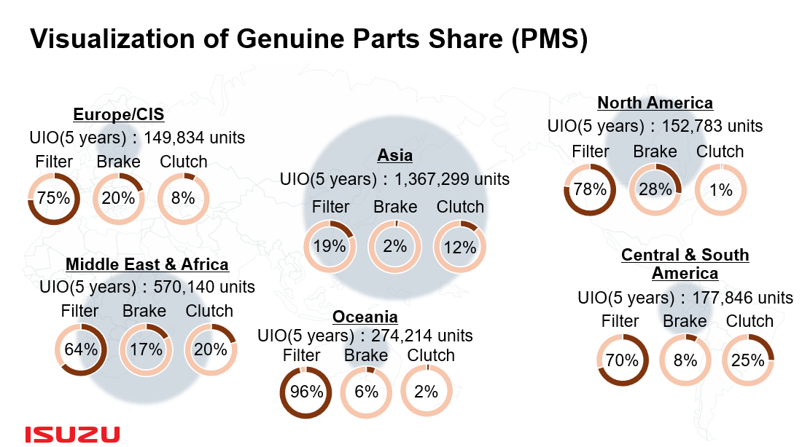

CV Conference Review (PMS Coverage)
How is this Cover Ratio calculated?
*From CV Conference Material
PMS Parts
Periodic Maintenance Service Parts. (Ex. Filter, Clutch, Brakes, Oil, etc.)
Vehicle UIO
Vehicle Units in Operation. (Number of vehicles still running in market)

Slide 8
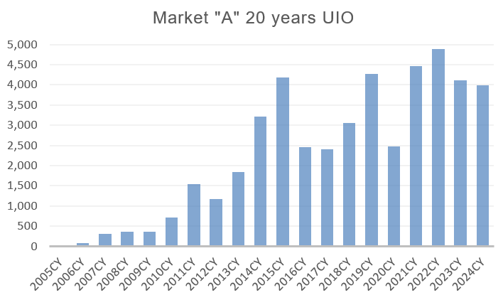
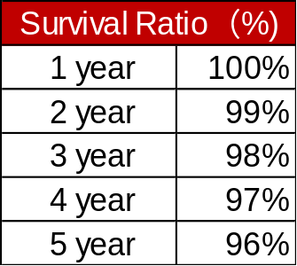

PMS Coverage Calculation
(1) Vehicle UIO
(3) Potential Demand
Based on UIO within 5 years as of 2024.
Potential Units × *Replacement Frequency
*Calculated based on 80,000km annual milage and items recommended replacement interval
(2) Potential Units
(4) Actual Demand
Assuming 50% of the UIO within 5 years.
Based on 2024CY IML Order Result.
CY | UIO | Total | Potential Unit
2020 | 2,476 | 19,926 | 9,963
2021 | 4,460
2022 | 4,892
2023 | 4,117
2024 | 3,981
(5) Coverage Calculation
50%
Actual Demand
PMS Coverage
Potential Demand

Slide 9



PMS Coverage Calculation
The cover ratio calculation method introduced earlier is just one possible approach.
Actual UIO and Replacement Frequency of each item differ across markets,
depending on the local environment and operating conditions.
Discussion of cover ratio figures is out of scope for this presentation.
Purpose is to make a relative comparison of cover ratios under same conditions.
To lead the discussion toward identifying the sales potential of PMS parts.

Slide 10
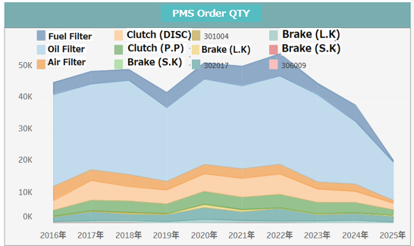

PMS Analysis
PMS Items Comparison Approach
Why Fuel Filter demand is much lower than Oil Filter?
Sample

Slide 11
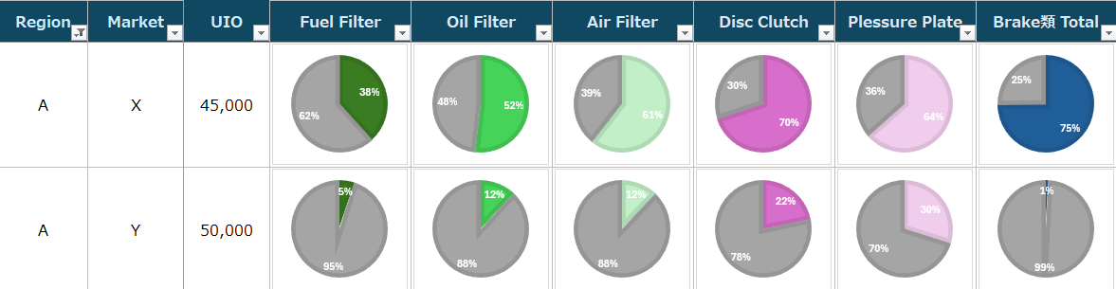

PMS Analysis
Market Comparison Approach
Sample
Same region, Similar UIO - Yet low Cover Ratio
What potential do we have?
Distributor’s Parts Manager from Market “Y”

Slide 12

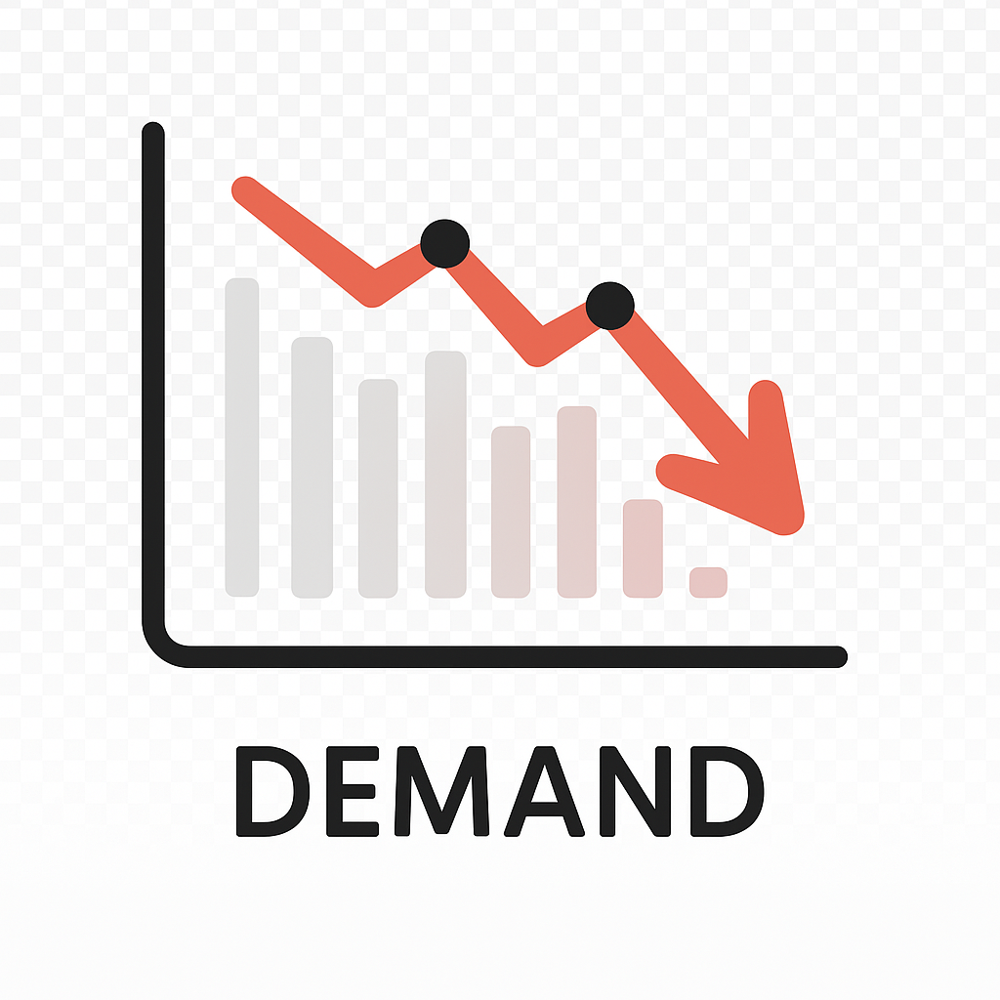

Summary
Why does PMS Cover Ratio is low?
Incentive Program
Maintenance Package
Pricing Strategy
Output of PMS Analysis → Sales Activity Ideas
PMS Sales
Market Info
Vehicle UIO
PMS Cover Ratio and Sales Trend Analysis
Why does PMS Sales Trend is declined?
Visualize PMS Trends and Cover Ratio using multiple data sources
Analyze and discuss together to identify the potential coverage
Come up with ideas for sales activity solutions

Slide 13
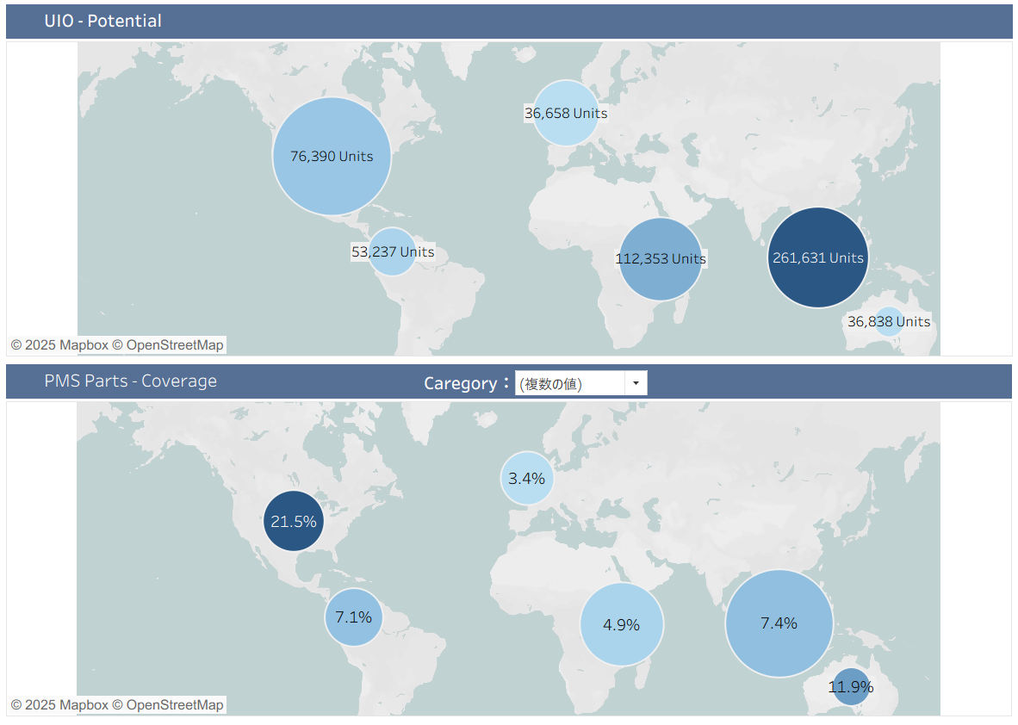
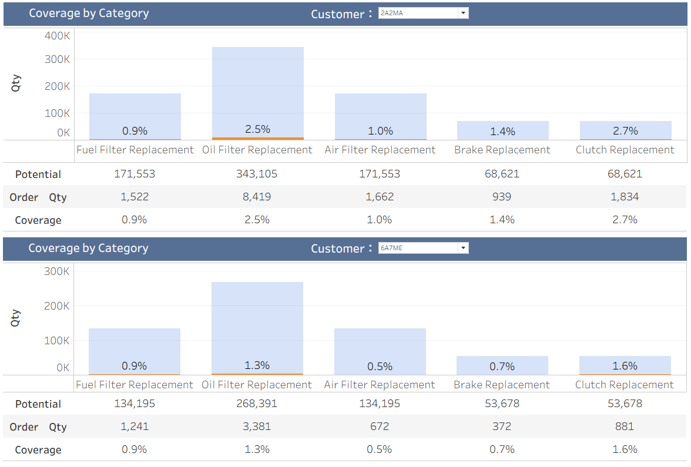

Information
“PMS Dashboard Demo” are ready at Booth
Let’s discover our market potential together!!

